Slide 1

GREENTECH ENGINEERS

Slide 2
COMPANY PROFILE
Greentech Engineers is very well equipped and established company to meet the future and having versatility to do any kind of work ,whether it could be simple channel cutting or critical piping job or any machines items and process equipment.
The Company has established and applies a QUALITY MANAGEMENT SYSTEM for general fabrication and is certified as per ISO 9001-2015 requirements by certification body of TVE Certification services private limited.

Slide 3
Contd ..
The unit is located in the industrial park of kattur engaged in full-fledged fabrication works, highly experienced, Qualified and dynamic engineers and staffs are engaged in the wings of manufacturing, inspection and quality control.
Apart from our existing machineries we utilise the machine centres / NDT Agencies and related industries in and around our Industrial estate to ensure the quality as well timely supply of products like sand blasting and painting/Rubber lining/FRP Coating etc.
Our continuous efforts is overall development of products as well our stringent quality control measures to perfectly meet our customer expectations.

Slide 4
OUR VISION
“Our vision is to meet the excellence by giving the best Quality on appropriate time.”
OUR OBJECTIVE
“Our main objective is to satisfy customer with better quality supplying the products on time as per the products on time as per the Real Customer.”

Slide 5
PRODUCTS
Green Tech Engineers as a leading manufacturing unit specialising in the fabrication of Heavy and special equipment. The Deliverable from the manufacturing unit Caters to a diversified range of industries like
Water Treatment
Chemical
Pharmaceuticals
Power
Automobile
Bio Technology
Process Industries
Food and Beverages etc.

Slide 6
We under take the following fabrication jobs
Fabrication and supply of pressure vessels(CS & SS)
Fabrication and supply of vertical and horizontal Storage Tanks ( C S & M S )
CS & MS piping
Chimneys
Silos
Water Treatment Equipment
Ducting
Heavy structural and Pipe Supports
Axial Fans/Centrifugal Fans / Blowers and Dampers
Clarifiers
Agitators
Lime Saturators.

Slide 7
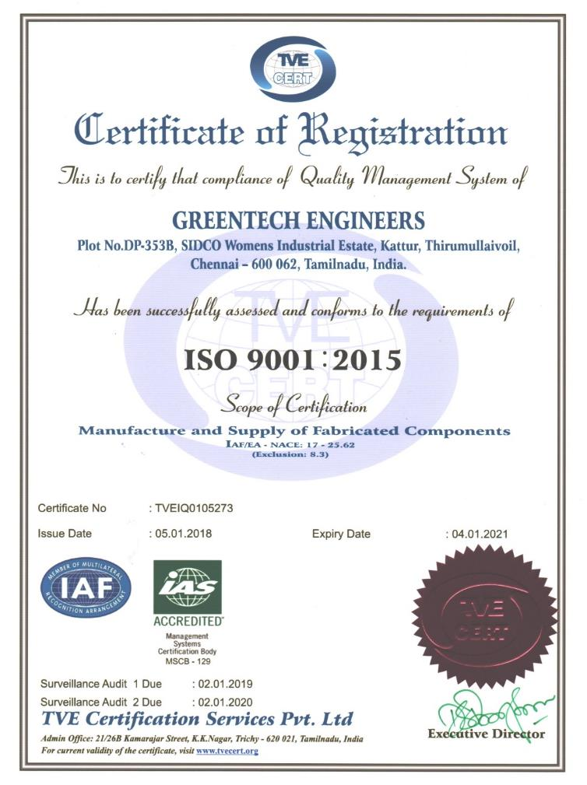
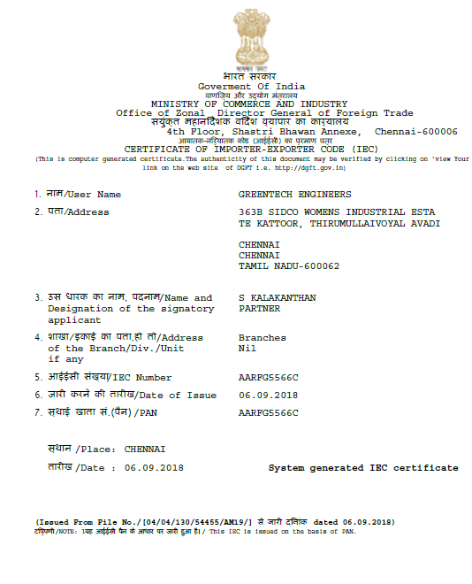
ISO 9001-2005 CERTIFICATE
EXPORT LICENSE

Slide 8
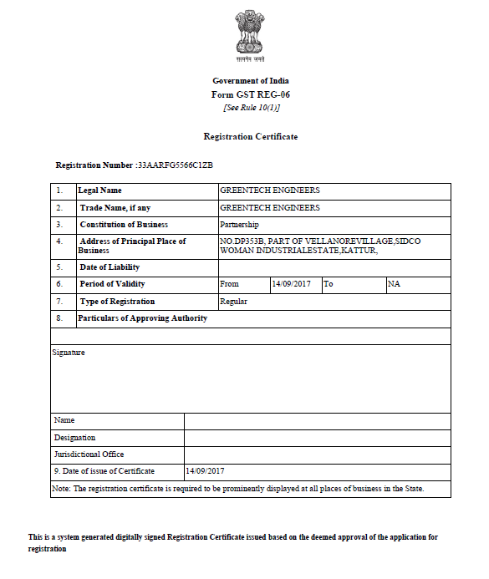
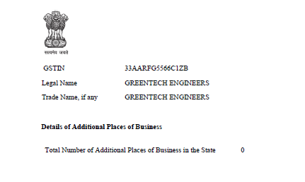
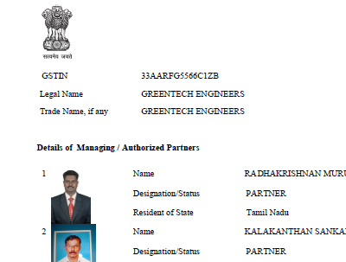
GST CERTIFICATE

Slide 9
LIST OF MACHINERIES
400 Amps Invertor Welding Machine - 6 Nos
250 Amps TIG / ARC Welding Machine - 1 No
200 Amps TIG / ARC Welding Machine - 2 Nos
200 Amps Welding Transformer - 1 No
200 Amps Welding Transformer - 1 No
600 Amps MIG / MAG Welding Machine - 1 No
Cot-70 Plasma cutting Machine - 1 No
3 HP Air Compressor - 1 No
1 ½” Cap pillar type drilling Machine - 1 No
14” Cutting Machine - 1 No
AG 7 Grinding Machine - 4 Nos
AG 4 Grinding Machine - 4 Nos

Slide 10
LIFTING ACCESSORIES
A Frame with 5 Ton chain pulley Block with trolley
Used Mobile Cranes by Hire
Hydraulic Jack 1 MTon to 10 MTon

Slide 11
SPACE AVAILABLITY
OPEN AREA - 9000 SQ.FT
BUILDING AREA - 2400 SQ.FT
TOTAL AREA - 11400 SQ.FT

Slide 12
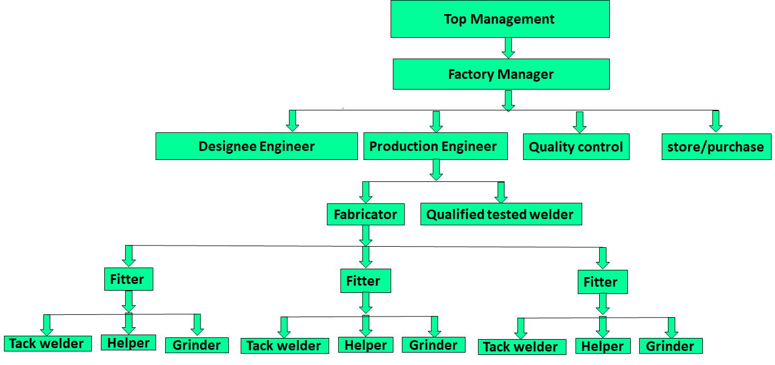
ORGANISATION STRUCTURE

Slide 13
MAN POWER
Factory Manager - 1 No
Design Engineer - 1 No
Production Engineer - 1 No
Fabricator - 2 Nos
Fitter - 6 Nos
Tack Welder - 6 Nos
Grinder - 6 Nos
Helper - 6 Nos
Qualified Welders - 6 Nos ( 4g / 3 g / 6 g )

Slide 14
INSPECTION AND TESTING
As per the Customers/ QUALITY ASSURANCE PLAN (QAP)
VISUAL
DIMENSION
LAB TEST-Chemical & Mechanical properties
PMI
Pneumatic Testing for RF Pads
NDT as per Drawing & QAP ( DPT / UT / RT / MPI )
Water fill Test
Hydro Test for Pressure Parts
Gas vanishing & Paint thickness check by ELCHO meter
SPARK Test by Rubber lining/FRP lining

Slide 15
OUR CLIENTS
M/s. ARVIND ENVISOLS LTD
M/s. COSMOS PURIFICATION SYSTEMS PVT LTD
M/s. HALLIBURTON OFFSHORE SERVICES INC
M/s. HALLIBURTON INDIA OPERATIONS PVT LTD
M/s. NAGARAJAN CONSTRUCTION PVT LTD

Slide 16
PROJECT REFERENCE
Sl No | Year | Description | Client | Value
 |  |  |  | Rs | Ps
1 | 2017-18 | PSF/ Softener ,ACF / Softener | H2O Engineers and Technologies | 3,42,200 | 00
2 | 2017-18 | Areation Tank | H2O Engineers and Technologies | 3,24,500 | 00
3 | 2017-18 | Bar Screen | H2O Engineers and Technologies | 6,490 | 00
4 | 2017-18 | PSF and ACF | H2O Engineers and Technologies | 76,700 | 00
5 | 2017-18 | MS Areation Tank | Hubert Enviro Care | 2,41,500 | 00
6 | 2017-18 | PSF and ACF | H2O Engineers and Technologies | 1,29,800 | 00
7 | 2017-18 | Areation Tank | H2O Engineers and Technologies | 3,00,900 | 00
8 | 2018-19 | 20,000gal MS Skid Tank | Halliburton Offshore Services Inc | 74,59,600 | 00
9 | 2018-19 | MS Skid Tank Man hole Flange Rectification | Halliburton Offshore Services Inc | 2,83,200 | 00
10 | 2018-19 | 1900gal Acid Tank/3000dia Waste tank /Blender Break Tank | Halliburton India Operation Pvt Ltd | 58,29,200 | 00
11 | 2018-19 | Acid Fume Bubblier system | Halliburton Offshore Services Inc | 12,31,920 | 00
12 | 2018-19 | Sea Pump Rectification Work | Halliburton Offshore Services Inc | 82,600 | 00

Slide 17
Sl No | Year | Description | Client | Value
 |  |  |  | Rs | Ps
13 | 2018-19 | Waste tank | Halliburton Offshore Services Inc | 13,20,037 | 00
14 | 2018-19 | Hatch Cover FRP Lining | Halliburton Offshore Services Inc | 6,60,800 | 00
15 | 2018-19 | Rectification Work for Sea Pump and piping | Halliburton Offshore Services Inc | 12,98,000 | 00
16 | 2018-19 | UF Skid | Cosmos Purification Systems Pvt Ltd | 1,68,360 | 00
17 | 2018-19 | AIR Tank | Halliburton India Operation Pvt Ltd | 1,88,800 | 00
18 | 2018-19 | MS UP Tubbier Frame | Cosmos Purification Systems Pvt Ltd | 86,140 | 00
19 | 2018-19 | Supply Butterfly Valves | Halliburton Offshore Services Inc | 10,84,540 | 00
20 | 2018-19 | RO Skid and UF Skid | Cosmos Purification Systems Pvt Ltd | 38,500 | 00
21 | 2019-20 | 30000gal Acid Tank | Halliburton India Operation Pvt Ltd | 1,27,49,000 | 00
22 | 2019-20 | Fabrication of Travers | Cosmos Purification Systems Pvt Ltd | 1,01,480 | 00
23 | 2019-20 | 1900gal Acid Tank | Halliburton India Operation Pvt Ltd | 27,61,200 | 00
24 | 2019-20 | RO Skid SS304 | Cosmos Purification Systems Pvt Ltd | 3,08,000 | 00
25 | 2019-20 | Liquid pump Skid Additive Frame | Halliburton India Operation Pvt Ltd | 5,19,200 | 00
26 | 2019-20 | Liquid Additive pumps Skid piping | Halliburton India Operation Pvt Ltd | 6,90,300 | 00

Slide 18
TURNOVER UPTO 3YEARS

Slide 19
CONTACT DETAILS
Company Name : Greentech Engineers
Address : No 315, Sidco Women's Industrial Estate, kattur, Tirumullaivoyal, Avadi, Chennai-600062.
Contact Person : S.Kamala Kanthan - Managing Partner
R.Murugan - Managing Partner
Mail id:greentechengineers373@gmail.com Mobile No:9500099116,7092988355,9962129588

Slide 20
PHOTOGRAPHS

Slide 21
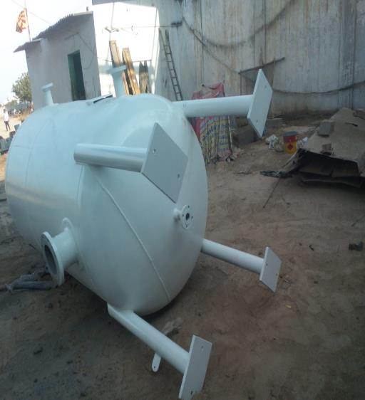
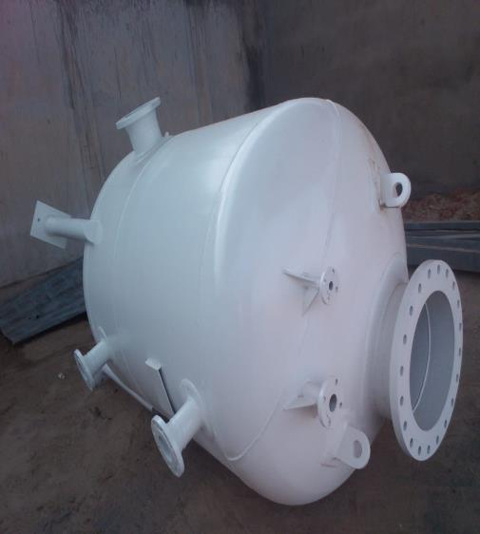
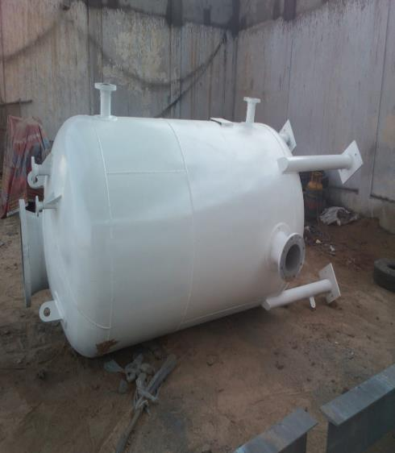
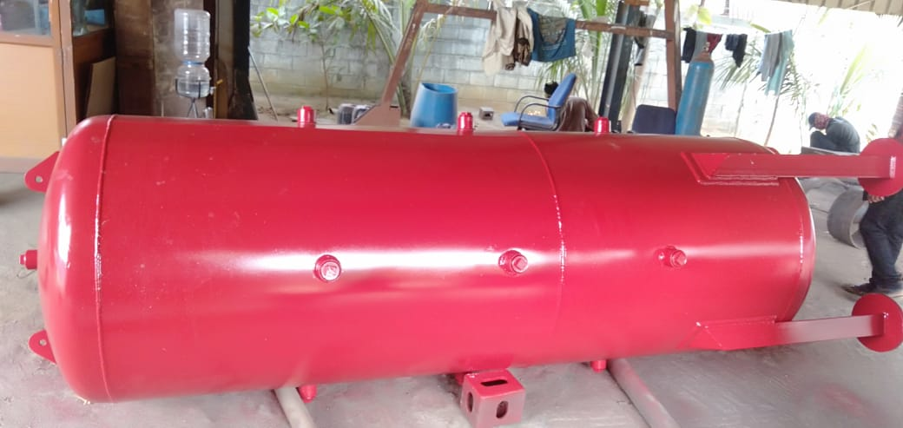
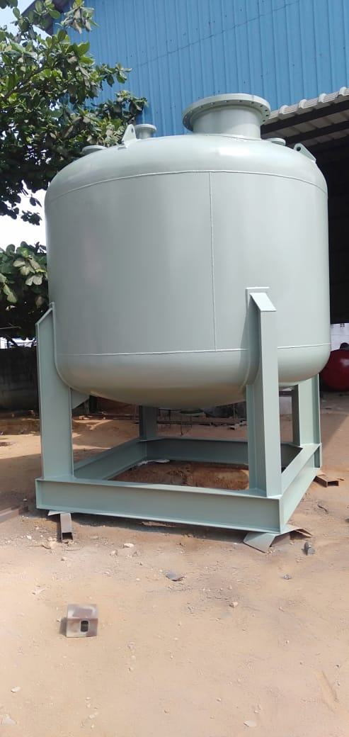
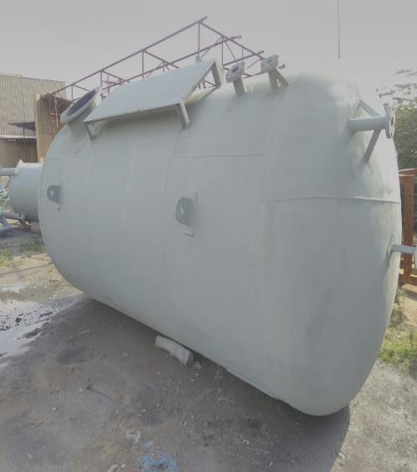

Slide 22
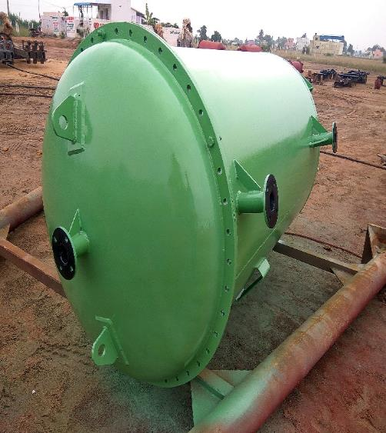
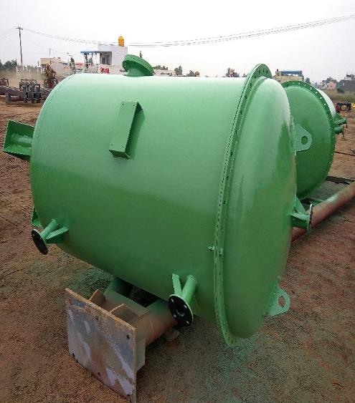
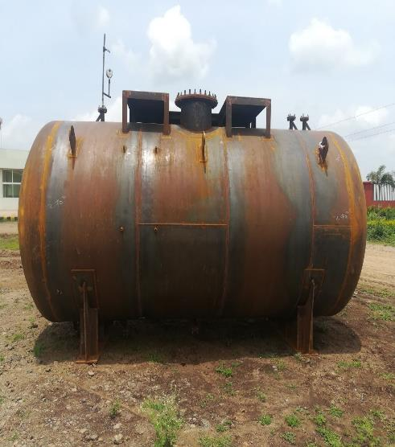
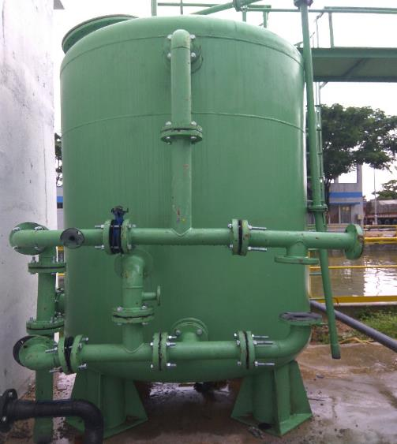
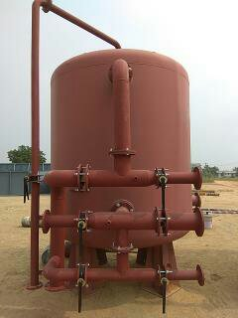
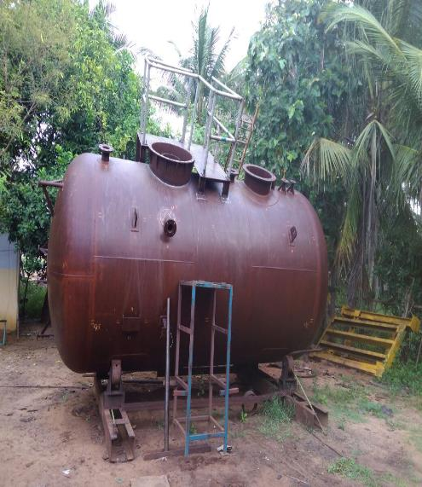

Slide 23
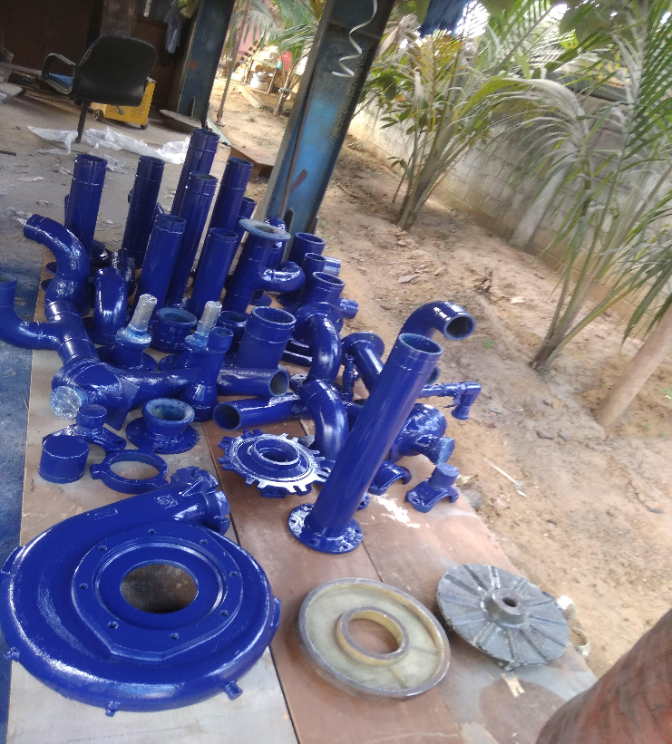
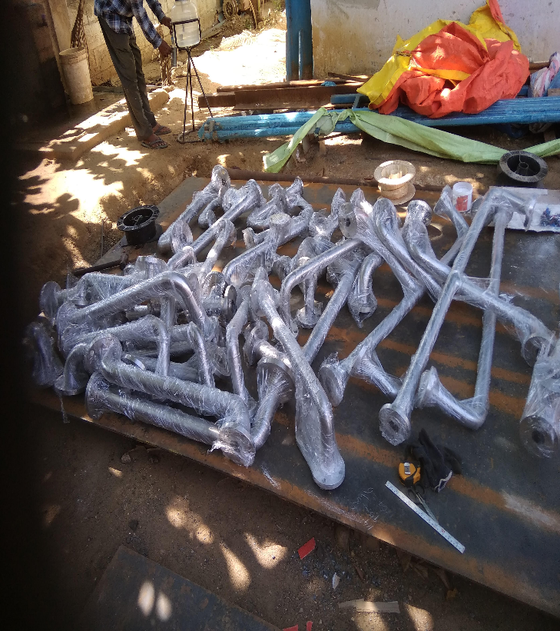
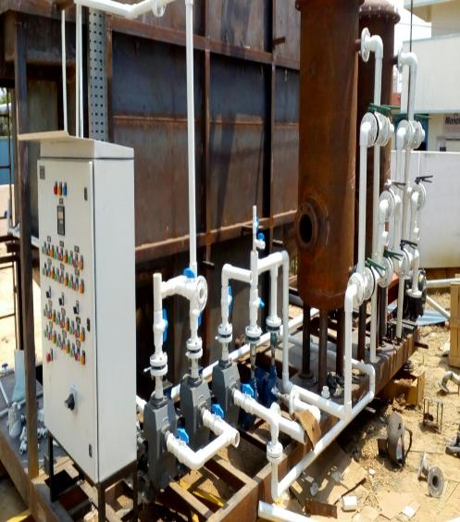
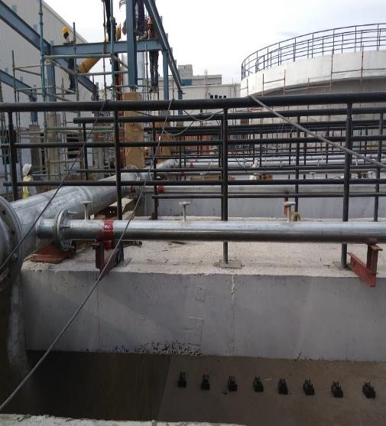
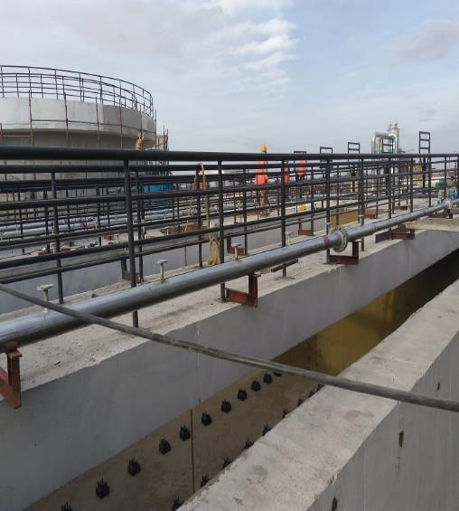
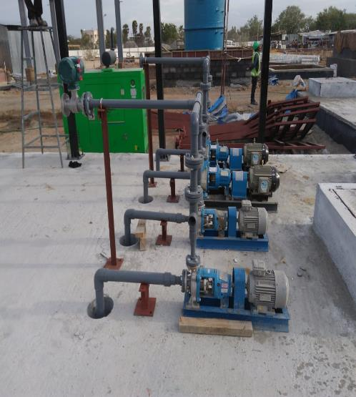

Slide 24
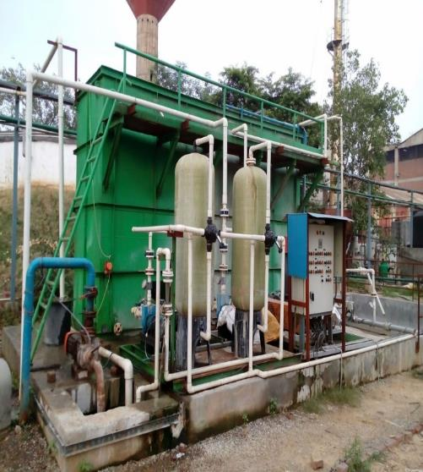
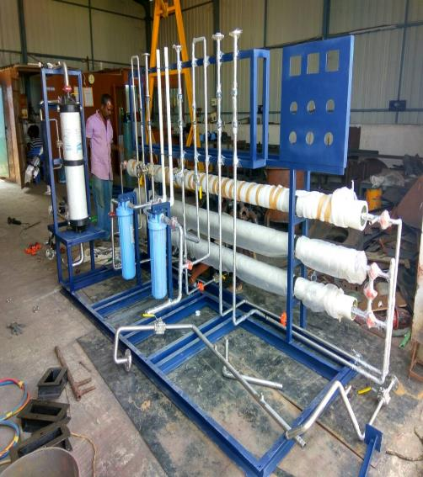
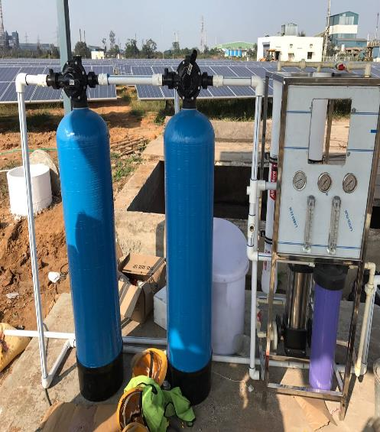
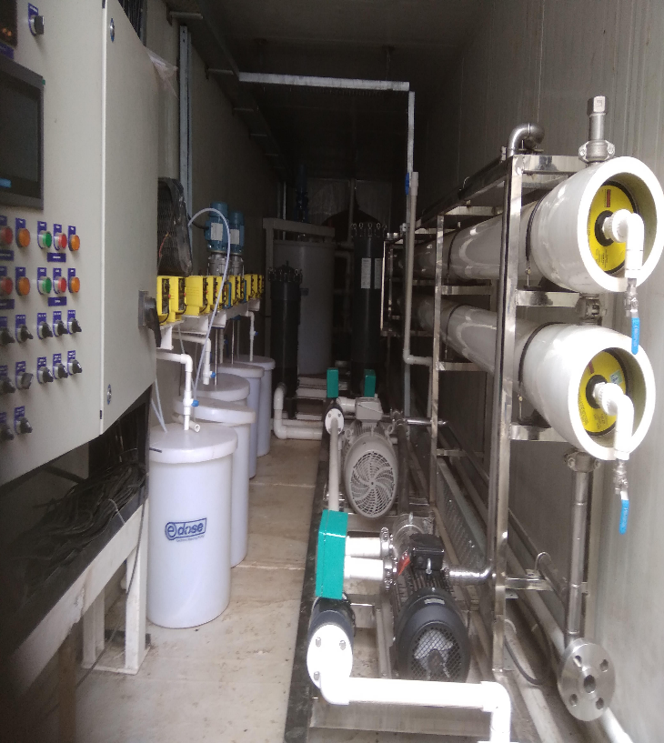
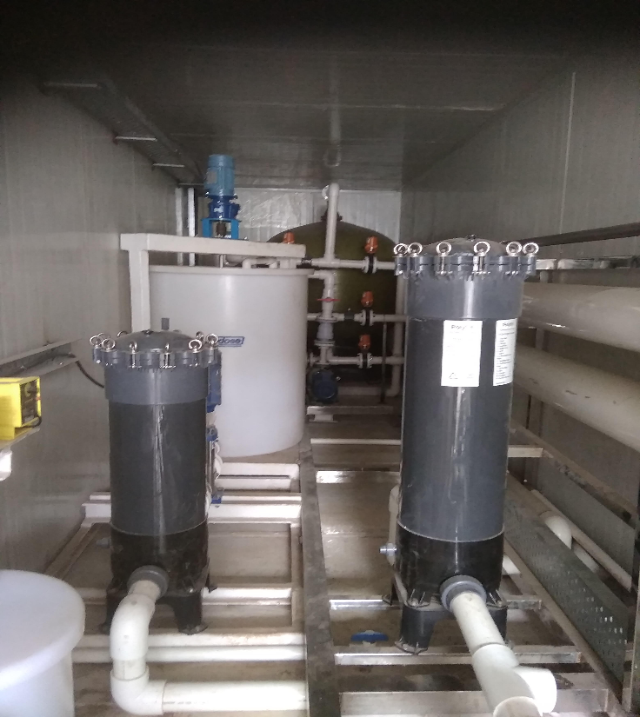
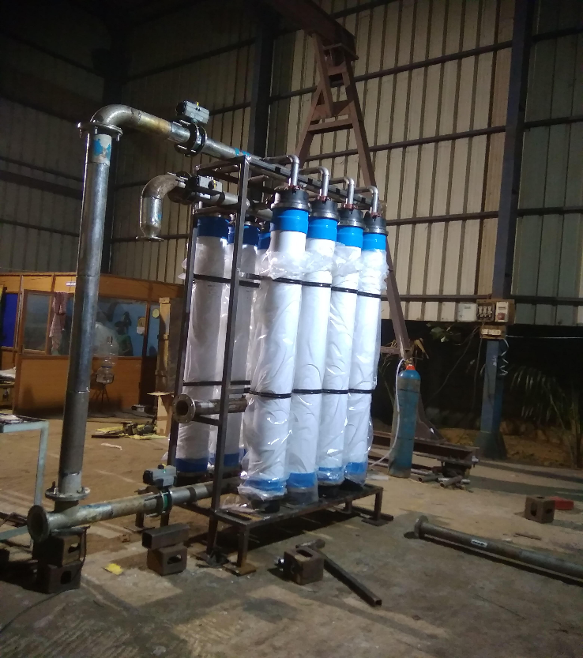

Slide 25
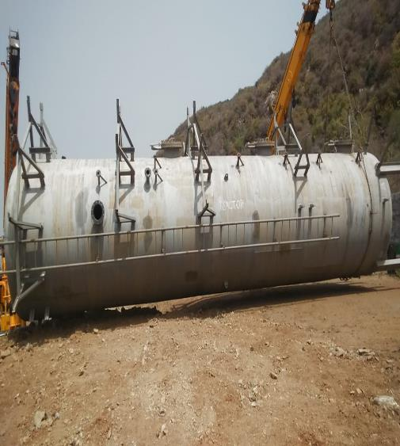
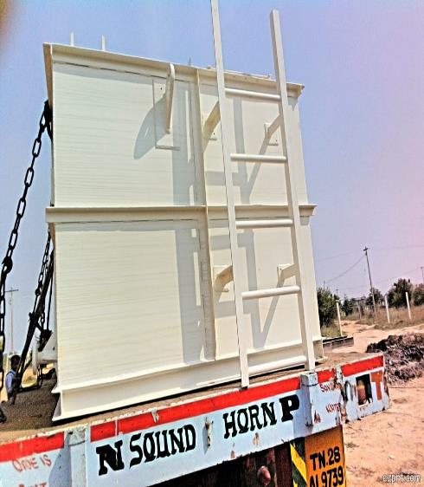
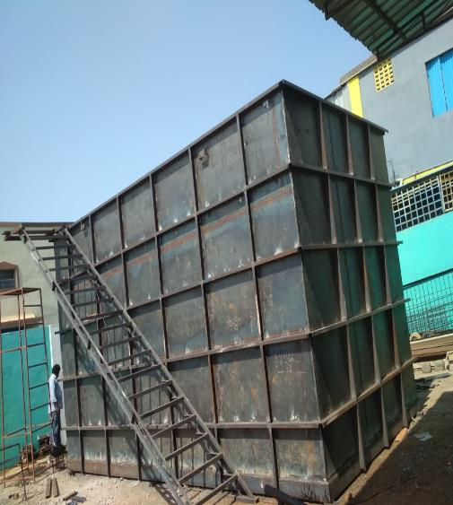
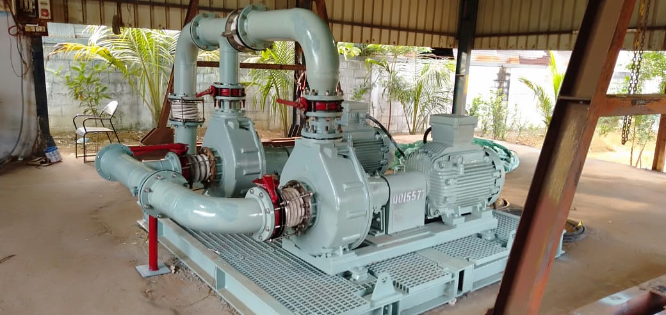
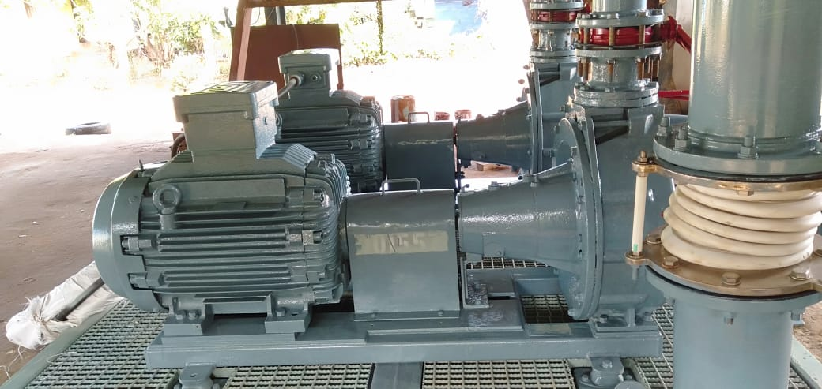
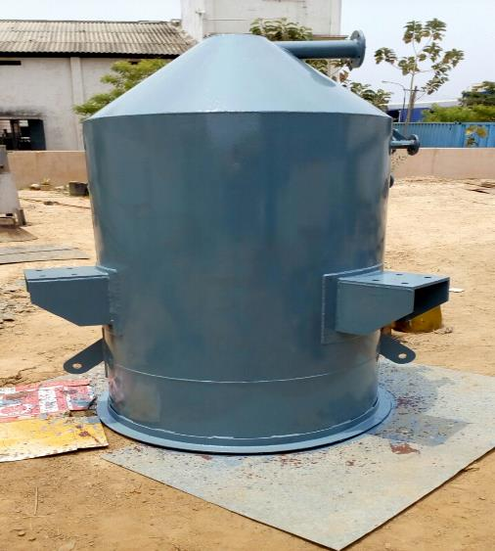

Slide 26
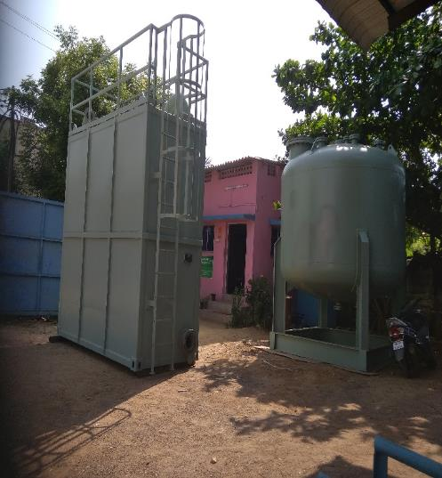
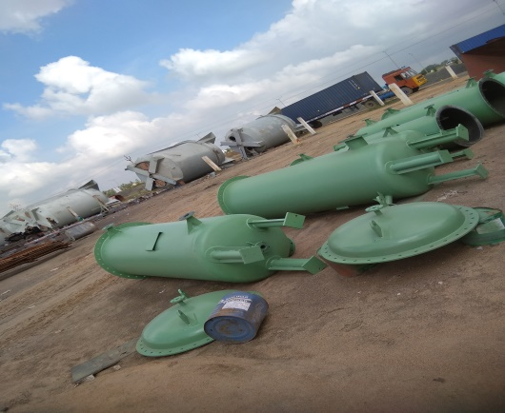

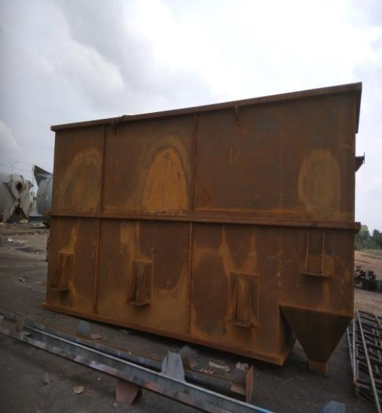
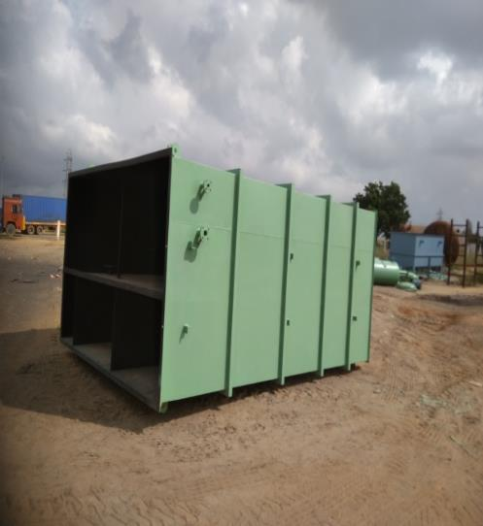
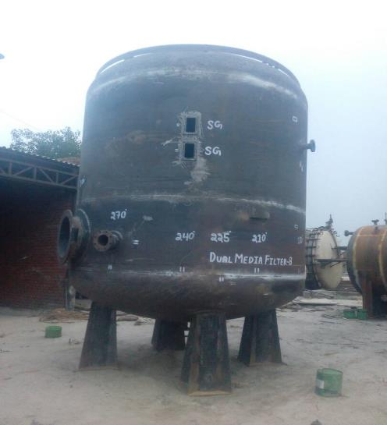

Slide 27
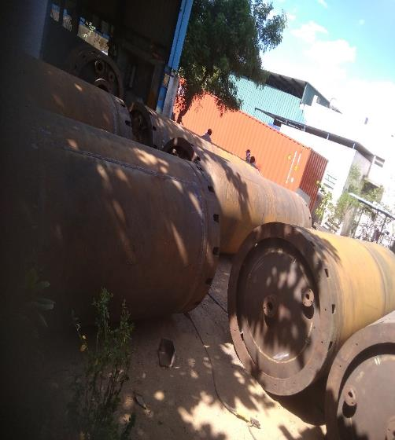
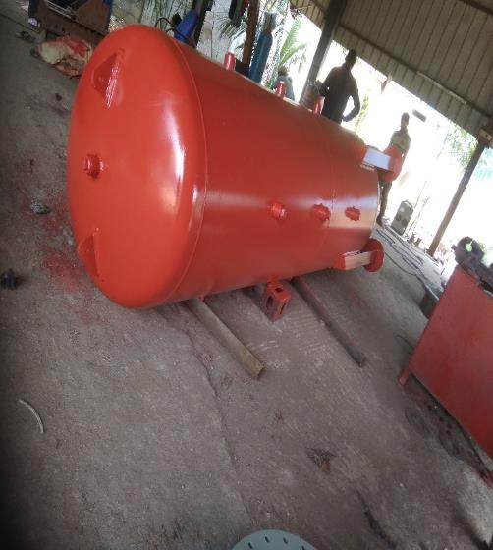
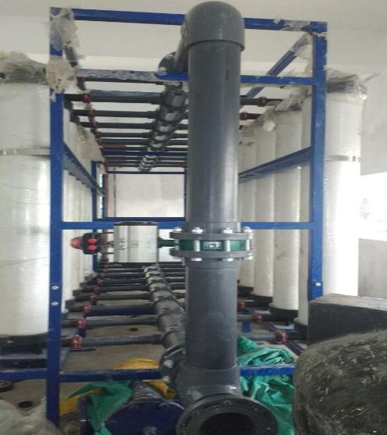
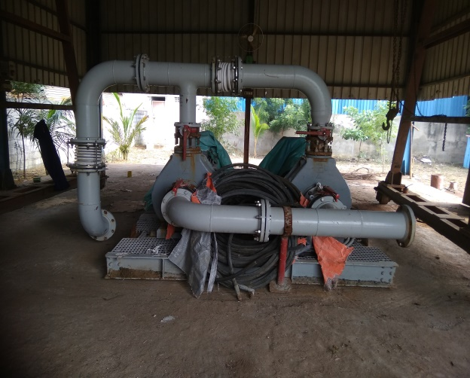
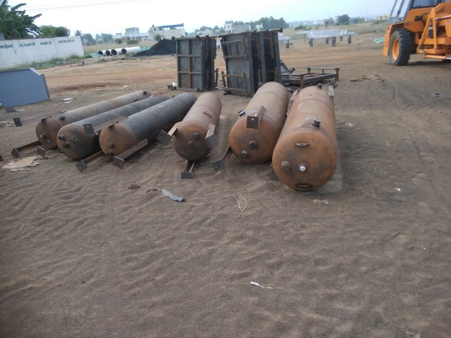
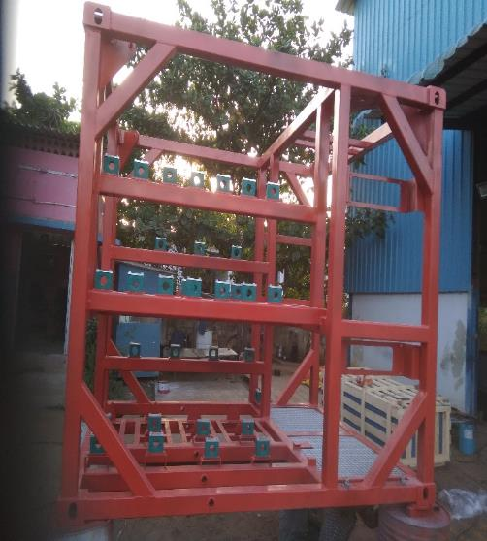

Slide 28
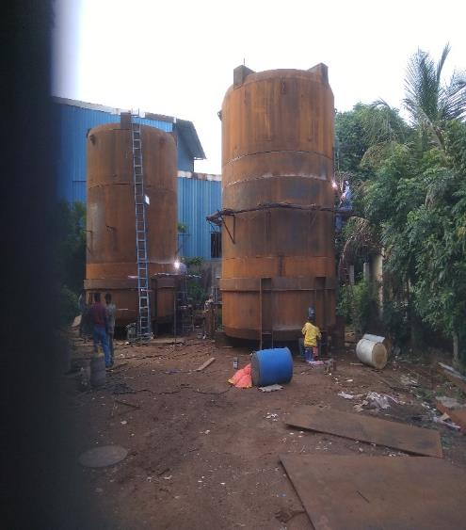
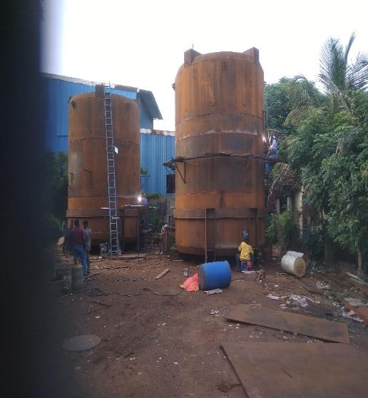
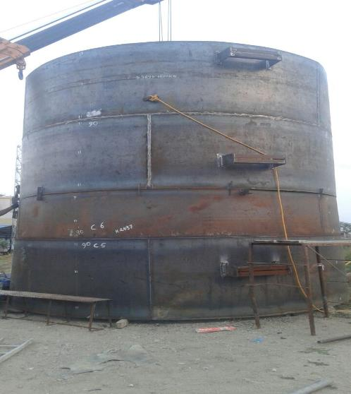




Slide 29







Slide 30







Slide 31



Slide 32







Slide 33
THANK YOU

